Slide 1
TranslateSubsPlayer
P. Karaseva
O. Markelov
Shatalov

Slide 2
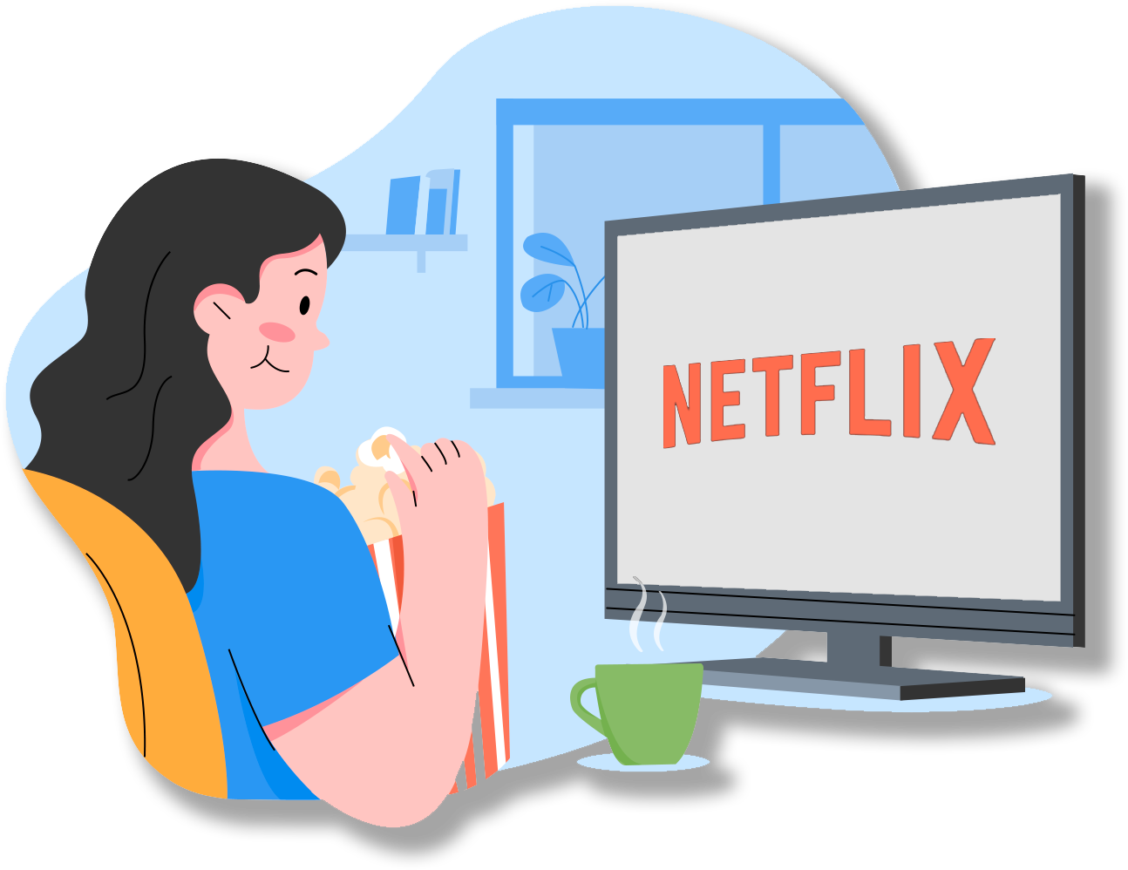
Project objective
Lots of people learn different foreign languages and lots of them like to watch movies and series as well.
Our goal is to provide these people with a tool, which can help to learn a language in a fun way.

Slide 3
Project objective
We are going to create:
Desktop cross-platform video player with the next features:
  translate any separate parts of subtitles during the video watching;
  create an interactive dictionary, based on the video watched;
  take a test on the material from the dictionary.
Server application, used for:
  keeping the dictionary in remote-access;
  synchronizing the dictionary on different devices;
  providing API for dictionary managing.
Web-application, used for working with the dictionary and testing system only.

Slide 4
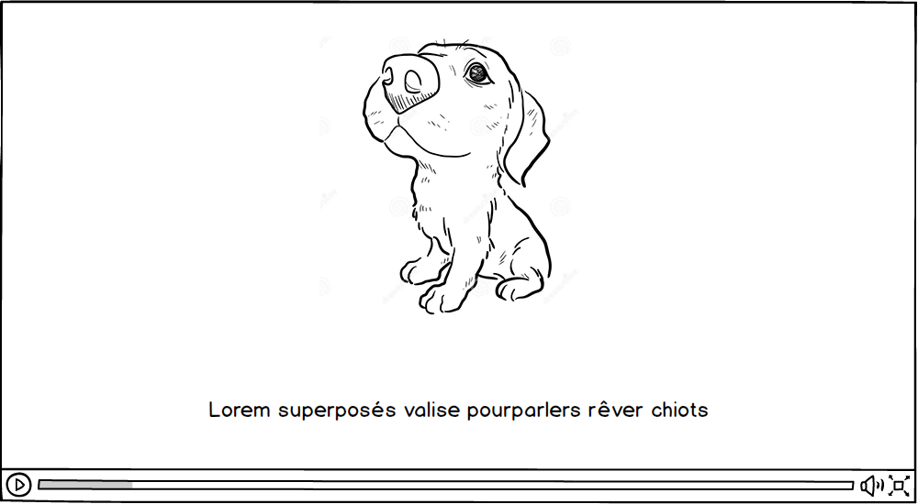

Slide 5
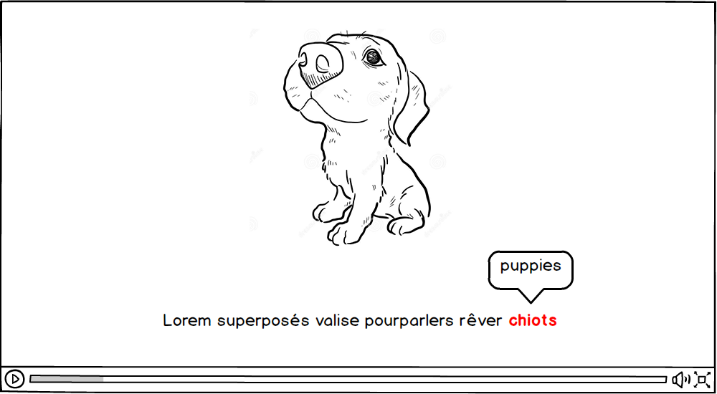

Slide 6
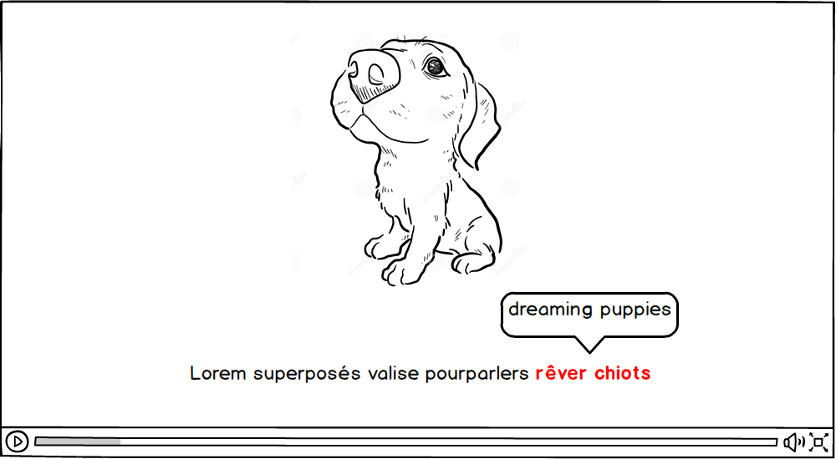

Slide 7
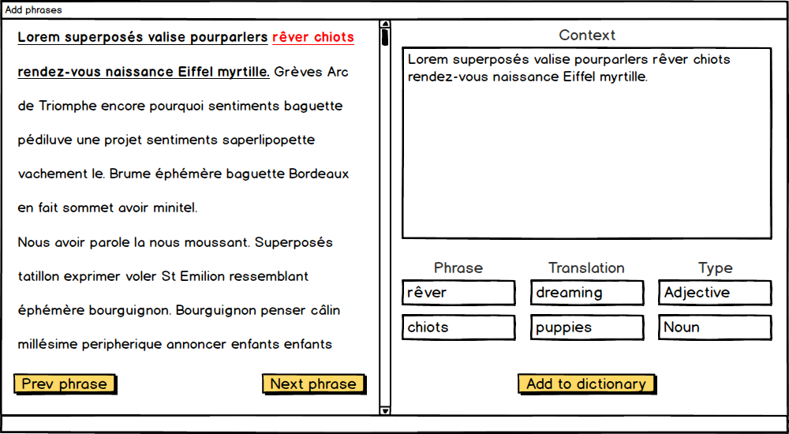

Slide 8
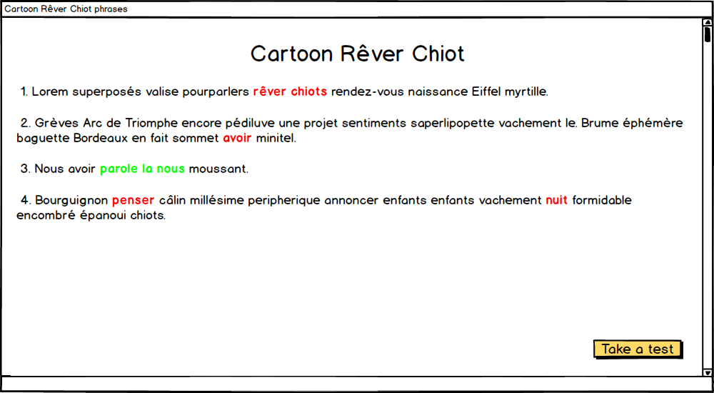

Slide 9
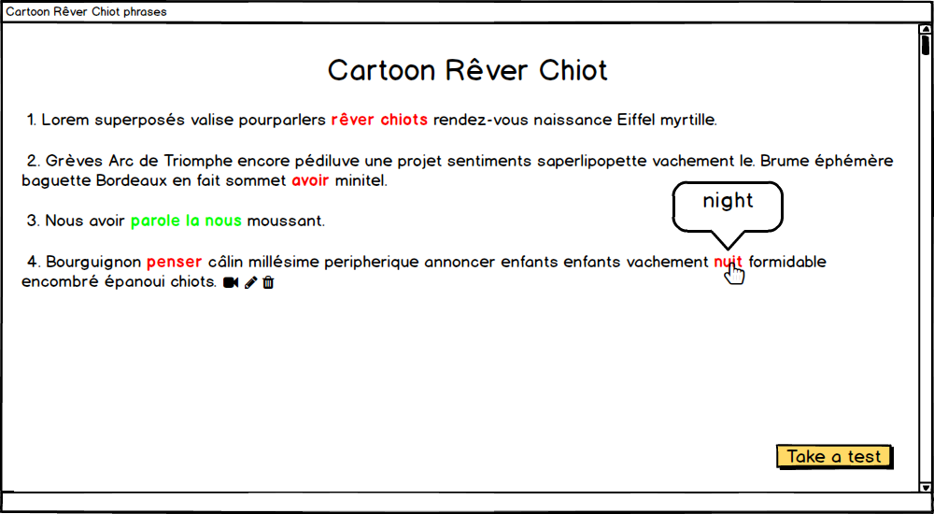

Slide 10
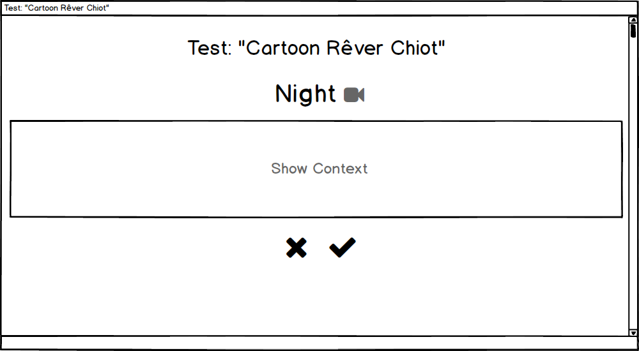

Slide 11
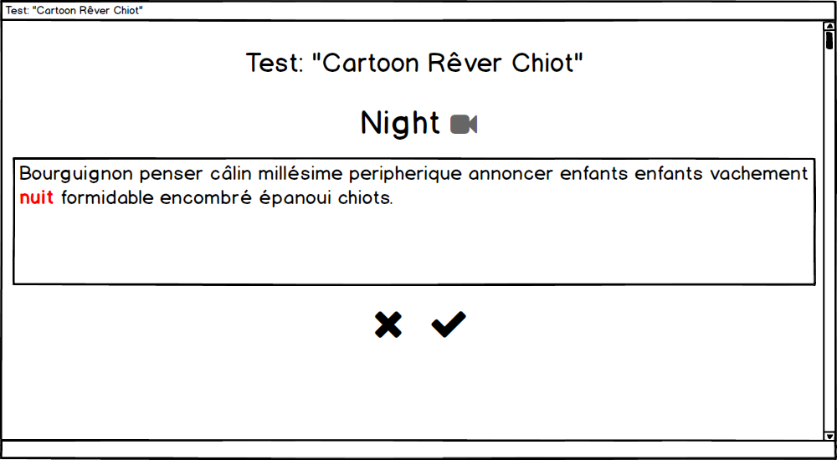

Slide 12





Possible technologies
Desktop video player:
Qt + libVLC (+ ffmpeg?) – seems too time-consuming;
JavaFX + vlcj (+ ffmpeg?) – seems too resource-consuming.
Server application:
Java's embedded HttpServer – seems too outdated;
Java Spring framework – seems too heavy.

Slide 13

Release dates
30.11.2020 – Player
15.03.2021 – Server application
19.04.2021 – Client Web-application
24.05.2021 – Production release!

